Slide 1

Evaluation of Different Manifold Learning Methods for Faces Ordering
Mingchen Li 21021409
Zinan Lin 20884086
Shihong Zhang 21018854
Lige Zhao 21033763

Slide 2
Problem description
Objectives
Re-ordering a sequence of shuffled faces dataset according to the face orientation
Evaluating the performance of several frequently utilized manifold learning algorithms on this task
Dataset description
33 snapshots of different face orientation of a same woman
All the snapshots labeled by the figure ID
Figure shape: 112 * 92 * 33
Manifold learning algorithms
Diffusion map
MDS
ISOMAP
LLE/MLLE
LTSA
t-SNE
PCA
UMAP
Evaluation criteria
Kendall Tau Correlation Coefficient
Visualization

Slide 3
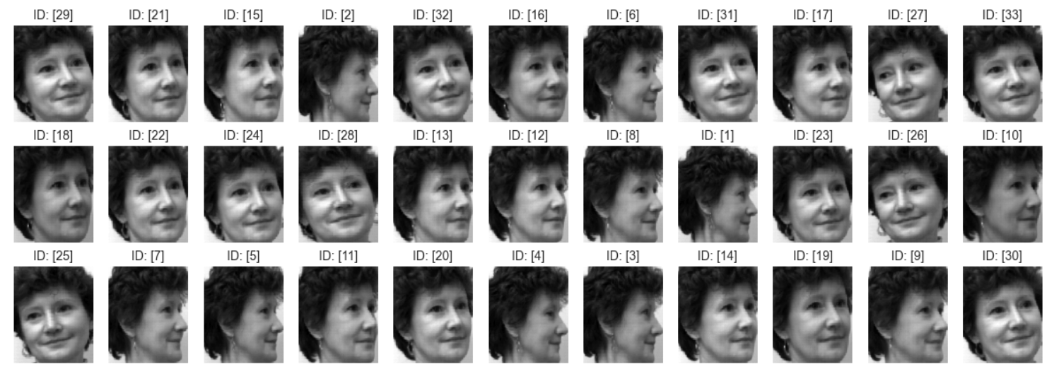
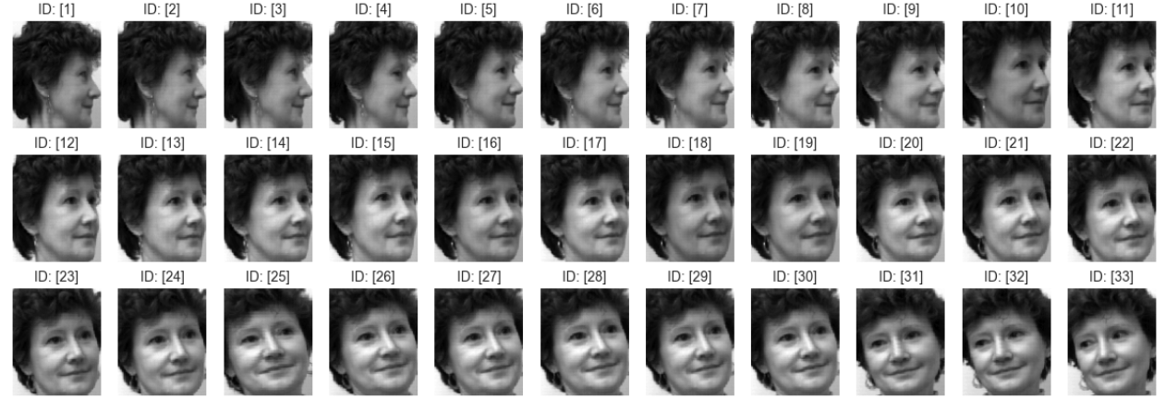
Dataset visualization
Shuffled data
Ground truth

Slide 4
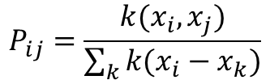
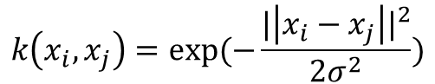
Diffusion map embedding: introduction
Diffusion map introduction: the workflow of diffusion map contains five steps
1. Constructing the Affinity Matrix: A common approach is to use a Gaussian kernel function to calculate the similarity between two points:
$$k\left(x_{i},x_{j}\right)=exp⁡(−\frac{{|\left|x_{i}−x_{j}\right||}^{2}}{2σ^{2}})$$
2. Transform to a Transition Matrix: This is typically achieved by normalizing each row of the affinity matrix
$$P_{ij}=\frac{k(x_{i},x_{j})}{\sum_{k}{k(x_{i}−x_{k})}}$$
3. Revealing Data Structure Through Diffusion Process: The core idea of diffusion maps is to detect the intrinsic structure of data through the cumulative result of multiple steps of probability transitions, i.e., by computing powers of P, where t is the time step.
4. Applying Eigen Decomposition: Performing an eigen decomposition on the transition matrix P yields eigenvalues and eigenvectors that can represent the data's intrinsic structure.
5. Selecting Principal Eigenvectors for Dimensionality Reduction: Select the first d largest eigenvalues' corresponding eigenvectors (ignoring the first one, as it usually corresponds to a trivial solution) to form a low-dimensional embedding representing each data point.

Slide 5
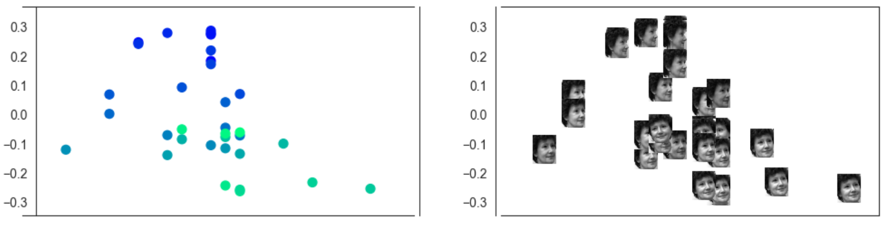
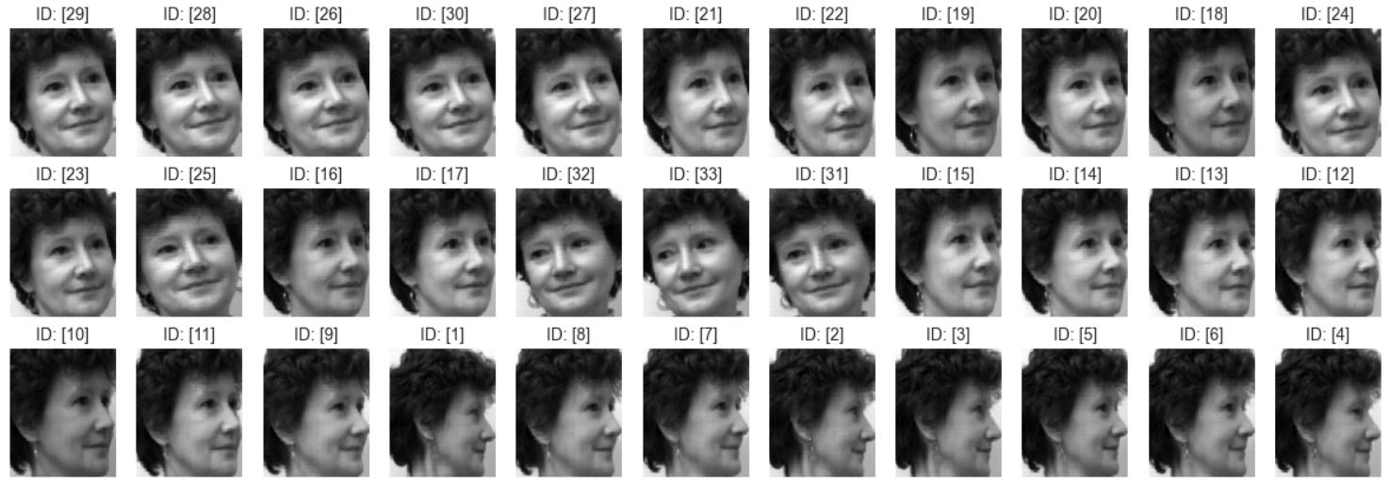
Diffusion map embedding: results visualization
Result visualization

Slide 6
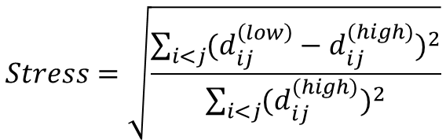
MDS embedding: introduction
MDS introduction: Multidimensional Scaling (MDS) is a statistical technique used for analyzing and visualizing the similarities or distances between data points. The goal of MDS is to place each data point in a lower-dimensional space such that the distances between these points closely reflect their distances in the original high-dimensional space.
Basic steps:
Distance Matrix: MDS starts with a distance matrix that contains the distances or dissimilarities between a set of data points.
Objective Function: MDS aims to find a configuration of points in a lower-dimensional space such that these points' distances approximate the original high-dimensional distances as closely as possible. A commonly used objective function is "stress," defined as:
Optimization Process: Using optimization algorithms (such as gradient descent, Newton's method, etc.), the positions of the points in the lower-dimensional space are continuously adjusted to minimize the stress function.
Dimensionality Reduction and Visualization: After optimization, the positions of each data point in the lower-dimensional space (usually two or three dimensions for ease of visualization) can be used to intuitively display the relative relationships and distances between data points.
$$Stress=\sqrt{\frac{\sum_{i<j}{{(d_{ij}^{\left(low\right)}−d_{ij}^{(high)})}^{2}}}{\sum_{i<j}{{(d_{ij}^{(high)})}^{2}}}}$$

Slide 7
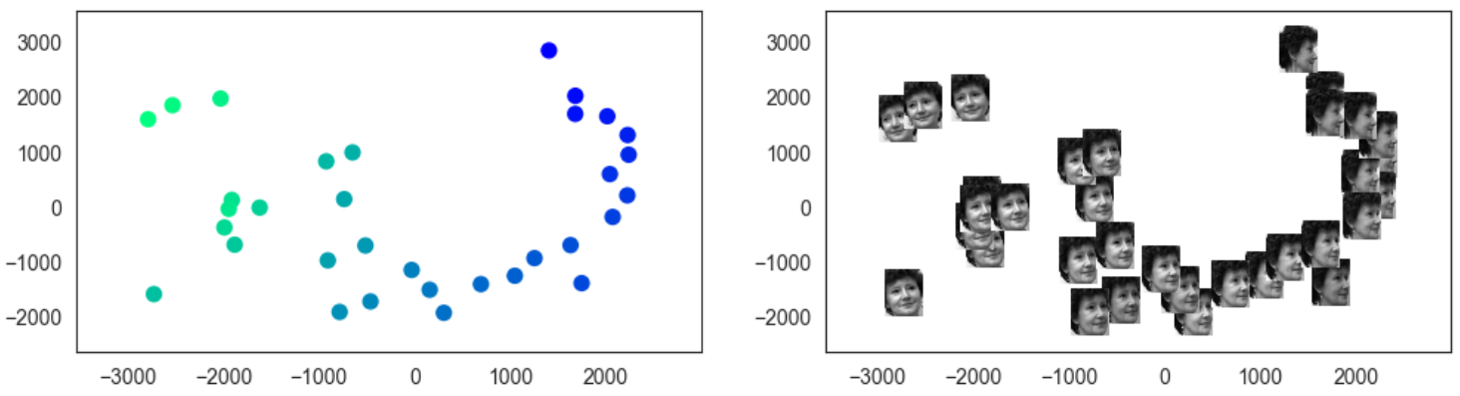
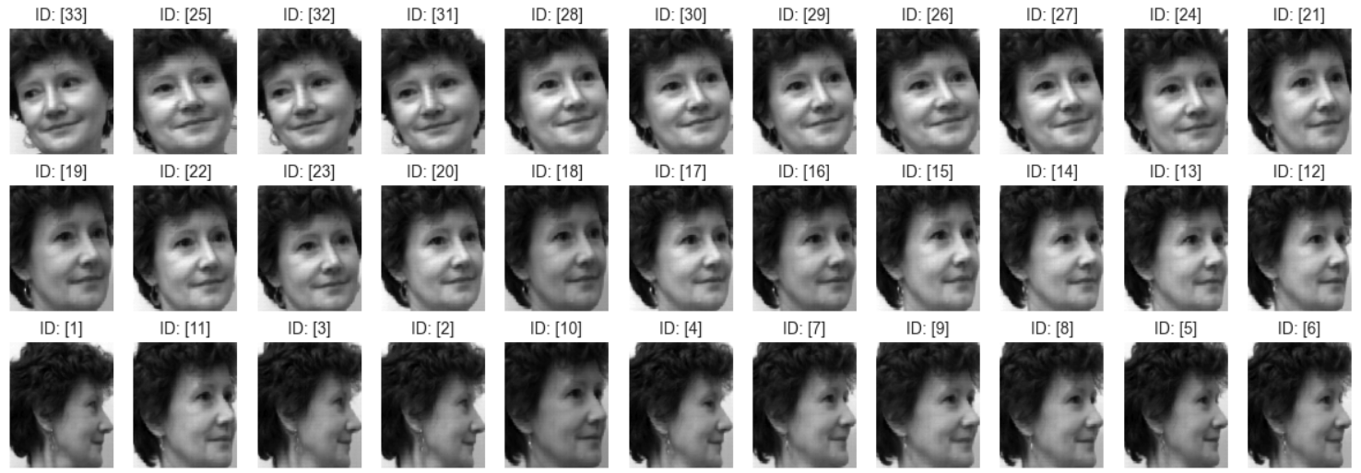
MDS embedding: results visualization
Result visualization

Slide 8
ISOMAP embedding: introduction
ISOMAP introduction: ISOMAP is a popular nonlinear dimensionality reduction method. It combines classical Multidimensional Scaling (MDS) with shortest path algorithms from complex network theory, aiming to preserve the global geometric structure of data in its original high-dimensional space.
Basic steps:
Neighborhood Graph Construction: Firstly, ISOMAP requires the construction of a neighborhood graph among the data points.
Calculating Shortest Paths: Based on the neighborhood graph, use shortest path algorithms (such as Dijkstra’s or Floyd-Warshall algorithm) to compute the shortest paths between any two points in the graph.
Multidimensional Scaling (MDS): Employ classical MDS to embed these shortest path distances into a lower-dimensional space.
Dimensionality Reduction and Visualization: Finally, the embedding of data points in the lower-dimensional space can be used for visualization and analysis of the data’s intrinsic structure, which helps to reveal the essential characteristics and relationships within the data.

Slide 9
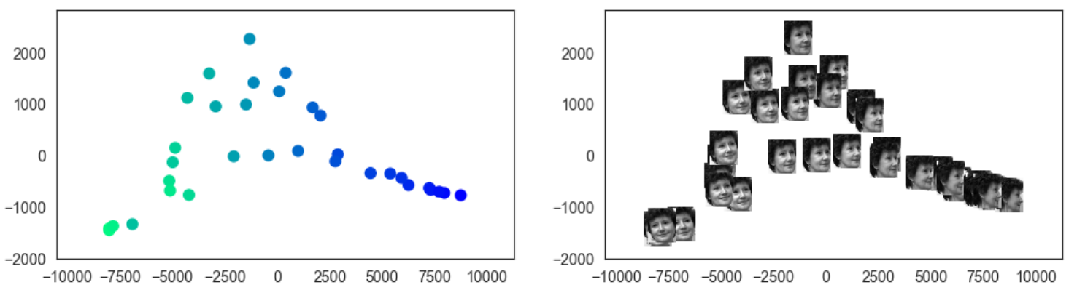
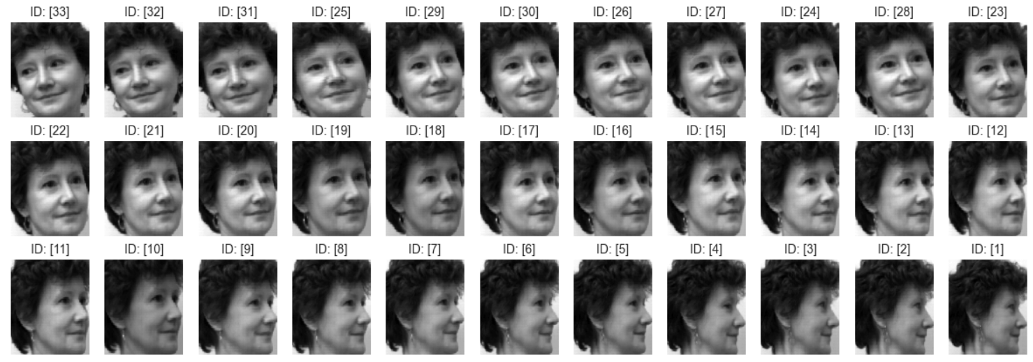
ISOMAP embedding: results visualization
Result visualization

Slide 10
LLE/MLLE embedding: introduction
LLE/MLLE introduction: LLE and MLLE achieve dimensionality reduction by preserving local properties of the data, aiming to reproduce the local relationships among points in the high-dimensional space in a lower-dimensional embedding.
Basic steps of LLE:
Neighborhood Selection: First, the LLE algorithm selects the nearest k neighbors for each data point, typically based on Euclidean distance.
Weight Matrix Construction: For each data point, LLE finds a set of weights that linearly reconstruct the point from its neighbors.
Low-Dimensional Embedding: The data is mapped to a lower-dimensional space while keeping the weights between each data point and its neighbors unchanged.
Basic steps of MLLE:
Estimation of Local Tangent Spaces: MLLE starts by estimating the local tangent spaces for each point, which is typically done by performing Principal Component Analysis (PCA) on the neighborhood of each point.
Improved Weight Calculation: After estimating the local tangent spaces, MLLE does not directly compute the reconstruction weights but calculates the weights by considering the projections of each point onto the local tangent spaces of its neighbors.
Low-Dimensional Embedding: MLLE also seeks a low-dimensional representation that minimizes the reconstruction error in the new space when linear combinations are formed using the calculated weights.

Slide 11
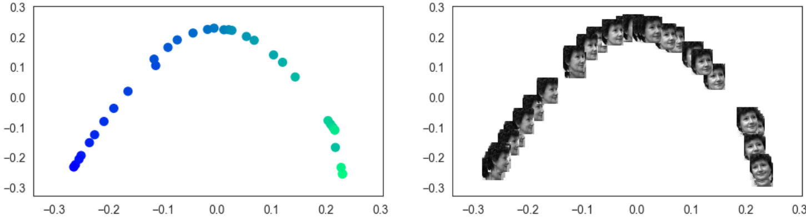
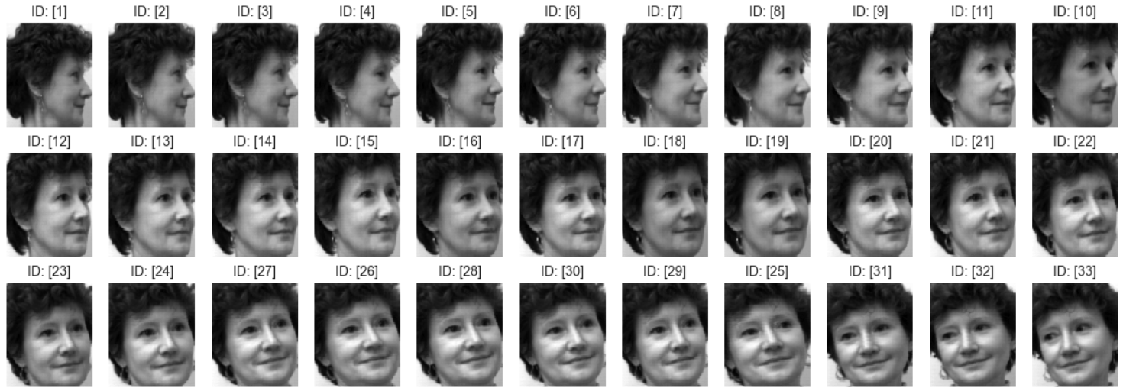
LLE/MLLE embedding: results of LLE
Result visualization

Slide 12
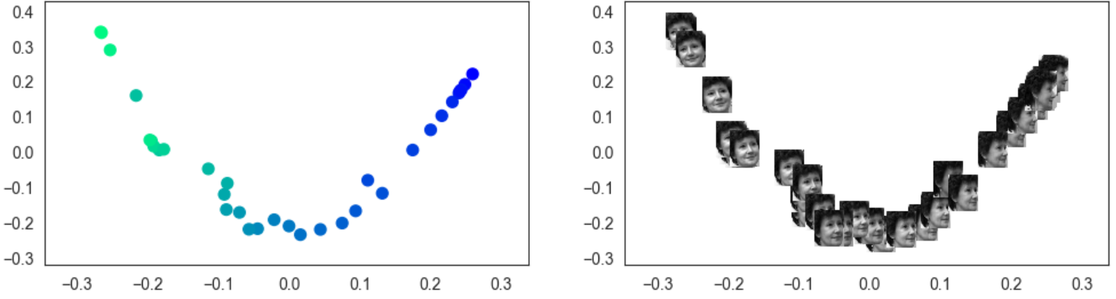
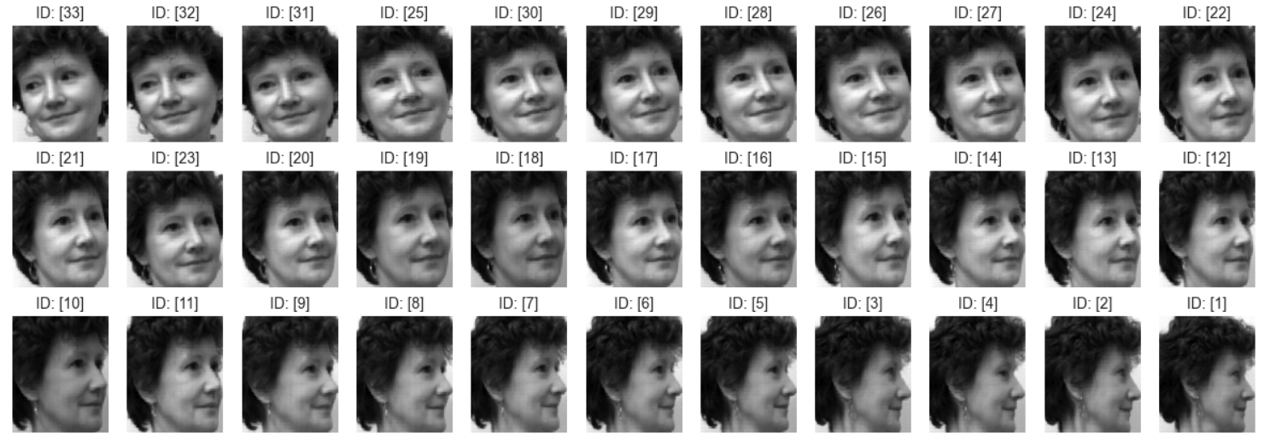
LLE/MLLE embedding: results of MLLE
Result visualization

Slide 13
LTSA embedding: introduction
LTSA introduction: LTSA aims to reveal and preserve the intrinsic geometric structures of data in a lower-dimensional space, but it achieves this by analyzing the local tangent spaces of the data.
Basic steps:
Neighborhood Selection: First, LTSA determines the nearest k neighbors for each data point, typically based on Euclidean distance.
Estimation of Local Tangent Spaces: For each data point and its neighborhood, LTSA calculates the local tangent spaces using Principal Component Analysis (PCA).
Alignment of Local Tangent Spaces: This step is the core of LTSA and aims to find a global coordinate system in which all local tangent spaces are aligned as well as possible.
Construction of Low-Dimensional Embedding: By solving a specific optimization problem, the LTSA algorithm finds a low-dimensional space where the arrangement of points maximally preserves the consistency of the local tangent vector structures from the original high-dimensional space.

Slide 14
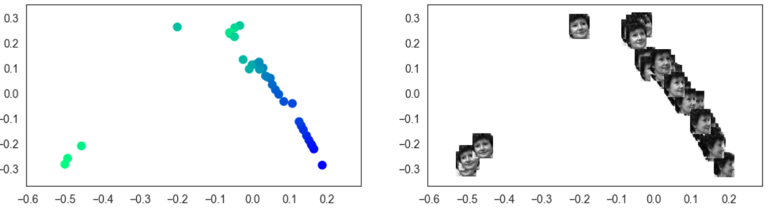
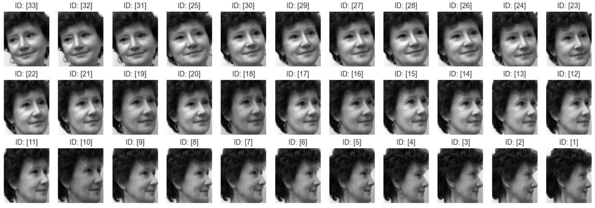
LTSA embedding: results visualization
Result visualization

Slide 15
t-SNE embedding: introduction
t-SNE introduction: t-SNE reduces dimensionality by preserving the local structure of data in high-dimensional space, aiming to bring similar objects closer and dissimilar objects farther apart in the low-dimensional space.
Basic steps:
Calculation of Similarity Probabilities: In high-dimensional space, t-SNE first calculates the conditional probabilities between each pair of data points, which reflect the likelihood of one point choosing another as its neighbor.
Similarity Probabilities in Low-Dimensional Mapping: In the low-dimensional space, t-SNE also calculates a set of similarity probabilities, but it uses a t-distribution instead of a Gaussian distribution.
Minimization of Kullback-Leibler Divergence: The goal of t-SNE is to make the similarity probability distributions in high-dimensional and low-dimensional spaces as close as possible. This is achieved by minimizing the Kullback-Leibler divergence between the two distributions.

Slide 16
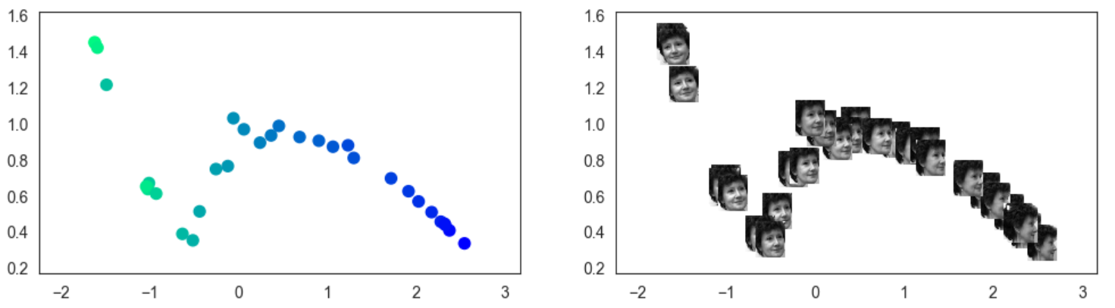
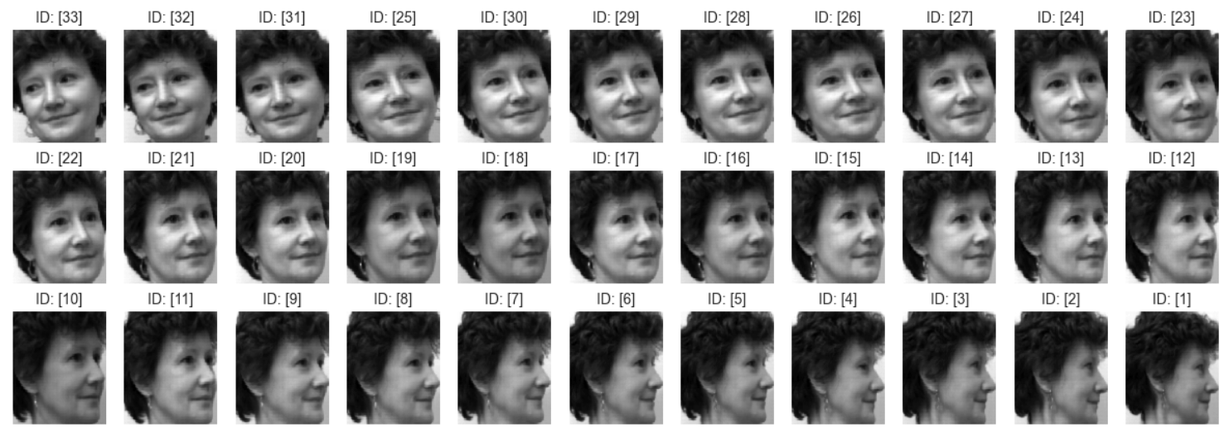
t-SNE embedding: results visualization
Hyper-parameter tuning:
'early_exaggeration': 1.201439702358722, 'learning_rate': 97.1458217859962, 'n_iter': 250.0, 'perplexity': 20.0, 'random_state': 63.0
Result visualization

Slide 17
PCA embedding: introduction
PCA introduction: PCA transforms original data into a new coordinate system through a linear transformation, aiming to maximize the variance of the data along the new coordinate axes, thereby achieving dimensionality reduction.
Basic steps:
Data Standardization: This involves centering each feature by subtracting its mean and optionally scaling it by dividing by its standard deviation.
Compute the Covariance Matrix: PCA starts by calculating the covariance matrix of the data. The covariance matrix describes the linear correlations between each pair of features, with diagonal elements representing the variance of each feature and off-diagonal elements representing the covariances between features.
Eigenvalue and Eigenvector Computation: The covariance matrix is then subjected to eigen-decomposition to solve for its eigenvalues and corresponding eigenvectors.
Select Principal Components: Once the eigenvalues and eigenvectors are calculated, they are usually sorted by the magnitude of the eigenvalues. Larger eigenvalues correspond to eigenvectors that point in the direction of greater variance in the data, and these directions are considered principal components.
Construct Projection Matrix and Transform Data: A projection matrix is formed using the selected eigenvectors. The original data is then multiplied by this projection matrix, projecting the original data onto the selected principal components.

Slide 18
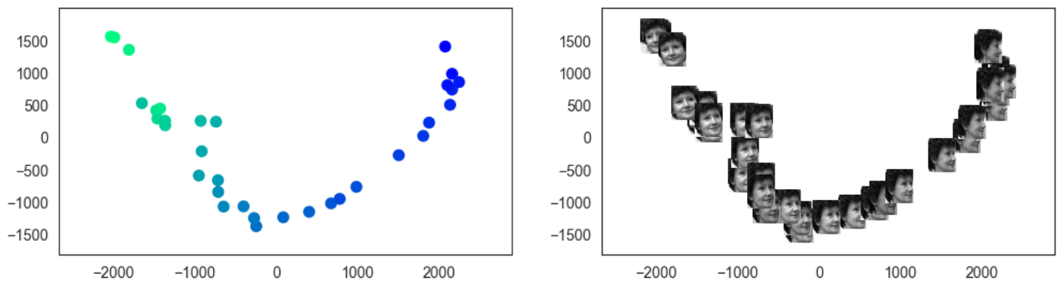
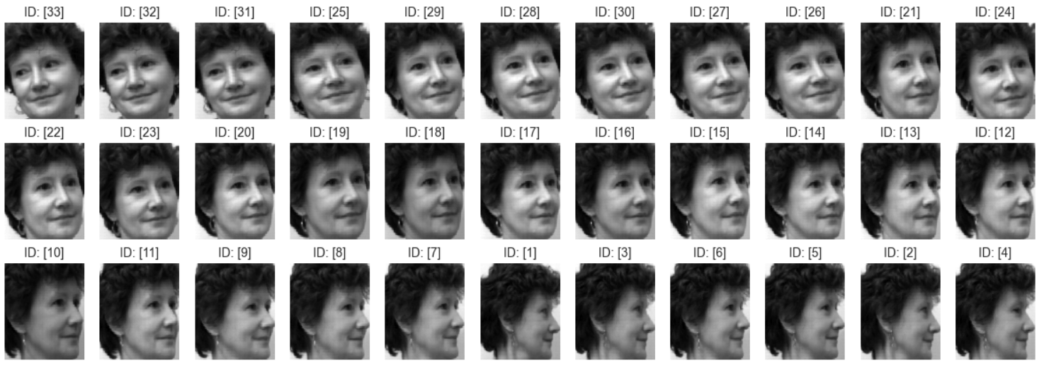
PCA embedding: results visualization
Result visualization

Slide 19
UMAP embedding: introduction
UMAP introduction: UMAP aims to preserve both local and global structures of data in high-dimensional space while mapping it to a lower-dimensional space.
Basic steps:
Constructing a Neighborhood Graph in High-dimensional Space: UMAP begins by constructing a local neighborhood for each data point in high-dimensional space. This is typically done by finding the K-nearest neighbors for each point, where K is a hyperparameter.
Optimizing the Low-dimensional Representation: Points in the low-dimensional space are initially placed randomly. UMAP's goal is to adjust the positions of these points so that the neighborhood relationships in the high-dimensional space are as well-preserved as possible in the low-dimensional space.
Applying Cross-entropy Optimization: UMAP uses stochastic gradient descent (SGD) or a similar optimization algorithm to minimize the cross-entropy loss. During this process, points in the low-dimensional space are continually adjusted based on their relative positions in the high-dimensional space until a satisfactory low-dimensional representation is found.

Slide 20
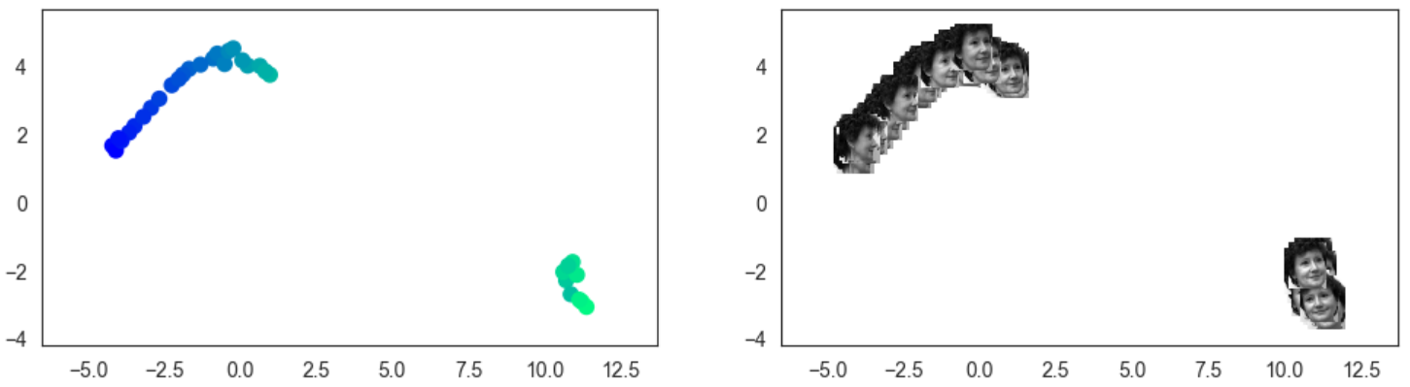
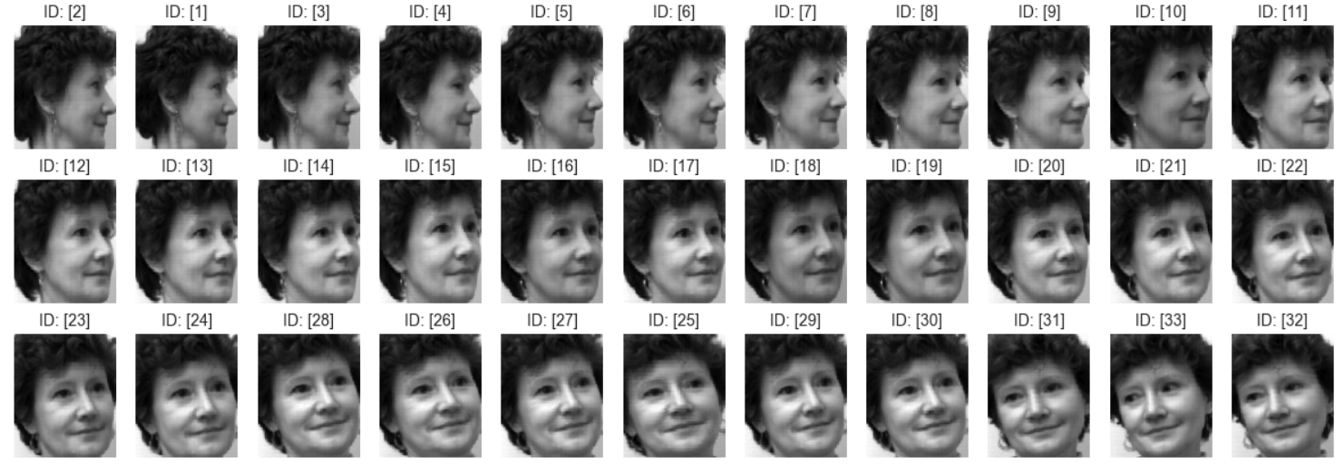
UMAP embedding: results visualization
Hyper-parameter tuning:
'init': 0, 'learning_rate': 0.3390340999256821, 'metric': 0, 'min_dist': 0.11941181340294027, 'n_epochs': 1900.0, 'random_state': 38.0, 'spread': 0.7155008213660682
Result visualization

Slide 21
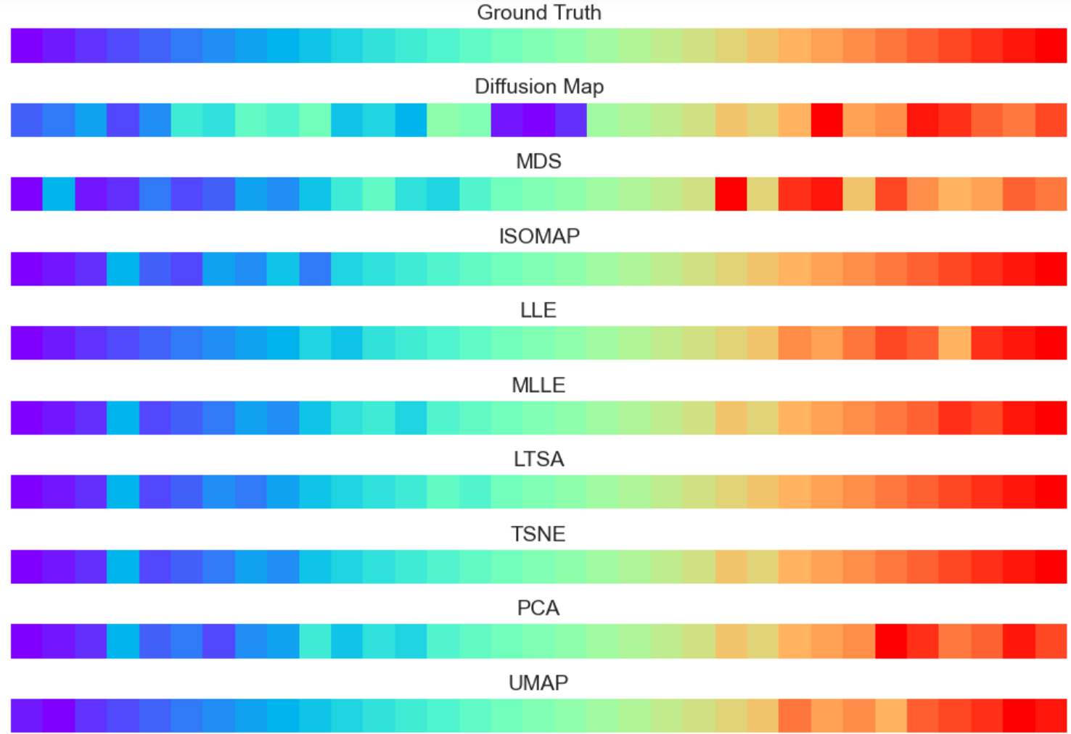
Performance comparison
Kendall Tau Correlation Coefficient:
Diffusion: -0.674
MDS: -0.818
ISOMAP: -0.962
LLE: 0.970
MLLE: -0.962
LTSA: -0.973
TSNE: -0.973
PCA: -0.920
UMAP: 0.973
Result visualization

